Slide 1
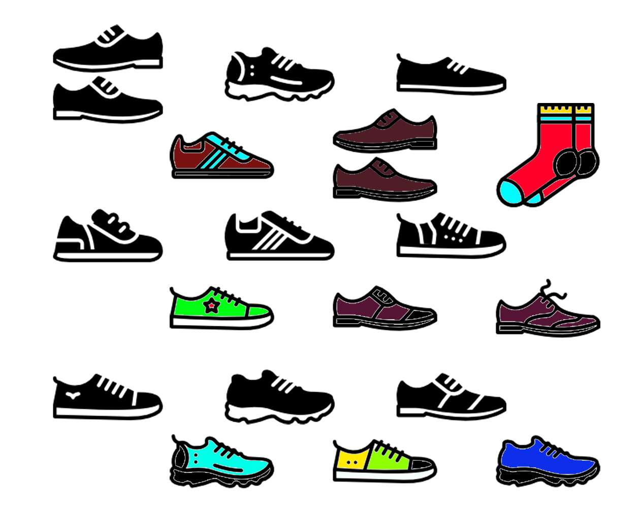
Mini Project 1B- SE(2021-2022) Department Of Computer Engineering
Online Footwear Shopping
SR NO. | NAMES | UIN NO.
1 | MOHAMMED JAWAD | 201P060
2 | ROHIT NAGAWELLY | 201P061
3 | SHAILESH MISHRA | 201P064

Slide 2

ABSTRACT
There has been scant empirical research devoted to footwear. The purpose of this is to gain a better understanding of how consumers search, select and evaluate footwear.
A mixed- research approach was employed for this study. A questionnaire survey and semi-structured interview were conducted with 21 students, including the five participants who took part in the eye-tracking study.
A total of six different pairs of shoes were selected for the investigation of eye-tracking process.
According to the results of this study, fit and comfort are the two most important factors for footwear evaluation. This also indicated that fit, comfort and style are closely related.
Many participants did not feel comfortable purchasing shoes online without trying them on.
The results of eye-tracking study indicated that majority of the participants spent more time viewing the top, side and toe of the shoes rather than the back and ankle.
Footwear
Visual Attribute
Eye-Tracking
Online Shopping
Mixed Methods Research

Slide 3
1. Introduction
Global use of the Internet increased by 676.3% from 2000 to 2014 (Internet World Stats, 2014) and in recent years, online shopping has become increasingly popular.
Canadian retail e-commerce sales increased43.5% from C$836.65 million in June 2016 to C$1.201 billion in June 2017 (Digital Commerce 360, 2017). Another report published by the Canadian Internet Registration Authority (CIRA, 2016) also confirms that the e-commerce business is growing in Canada.
In this CIRA report, many respondents indicated that ‘clothing’(42%) was the most common online purchase, followed by ‘flights or travel packages’ (40%), and ‘books’ (34%).
In addition to boosting companies’ sales, the Internet has been widely used to enhance brand image and perceived values (Levenburg, 2005) through different online marketing strategies.
In Canada, more than 50% of Internet- connected households used more than one device for various online shopping activities such as browsing, searching, comparing, evaluating and buying (Sweet et al., 2012). According to many reports and surveys (e.g., Coughlan, 2016; Noble & Noble, 2000), young people spend more time socializing, playing and ‘surfing’ online than watching television programs.
The increased use of the Internet for different activities (e.g., entertainment, information search and purchases) is a phenomenon that suggests the great potential that lies ahead for fashion e-retailing businesses. The overarching objective of this study is to understand how online consumers navigate, select and evaluate footwear.

Slide 4
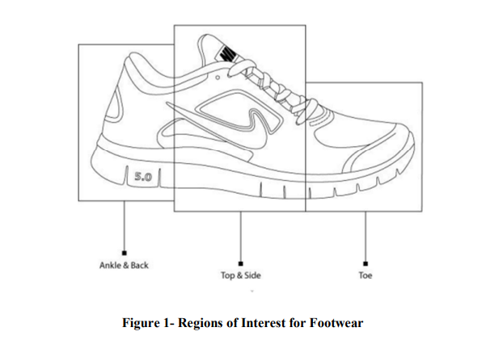
2. Visual Representation
The aesthetic pleasure of a product (style, color and texture) can drive consumers’ interest in purchasing the product.
According to the theory of visual rhetoric, images can communicate complex messages and ideas faster than textual information.
A product image and its associative meaning can enhance consumers’ long term memories as well as increase the likelihood of a purchase when the need for that product arises.
In other words, online visual images can greatly influence consumers’ purchasing intentions and their perceptions toward a product . With such perspective, it is important to understand how the online shoppers view a product on the digital space.
Do online shoppers pay more attention to certain areas of a pair of shoes?

Slide 5
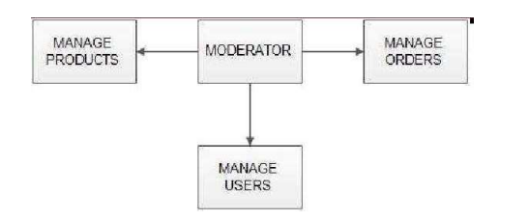
ADMIN
A moderator/admin is considered as a staff who can manage orders for the time being. As a future update moderator may give facility to add and manage his own products.
Moderators can reduce the work load of admin. Now moderator has all the privilege an admin having except managing other moderators.
He can add products and users.
He can also check the orders and edit his profile.
Manage Products
Manage Users
Manage Others

Slide 6
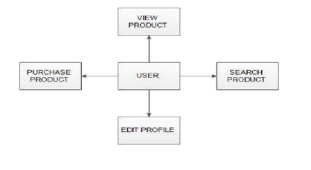
Users
Registration :A new user will have to register in the system by providing essential details in order to view the products in the system. The admin must accept a new user by unblocking him.
Login : A user must login with his user name and password to the system after registration.
View products : User can view the list of products based on their names after successful login. A detailed description of a particular product with product name ,product-details, product image, price can be viewed by users.
Search product : Users can search for a particular product in the list by name.
Add to cart : The user can add the desired product into his cart by clicking add to cart option on the product. He can view his cart by clicking on the cart button. All products added by cart can be viewed in the cart. User can remove an item from the cart by clicking remove.
Submit cart : After confirming the items in the cart the user can submit the cart by providing a delivery address .
On successful submitting the cart will become empty.
Edit profile : The user can view and edit the profile.

Slide 7
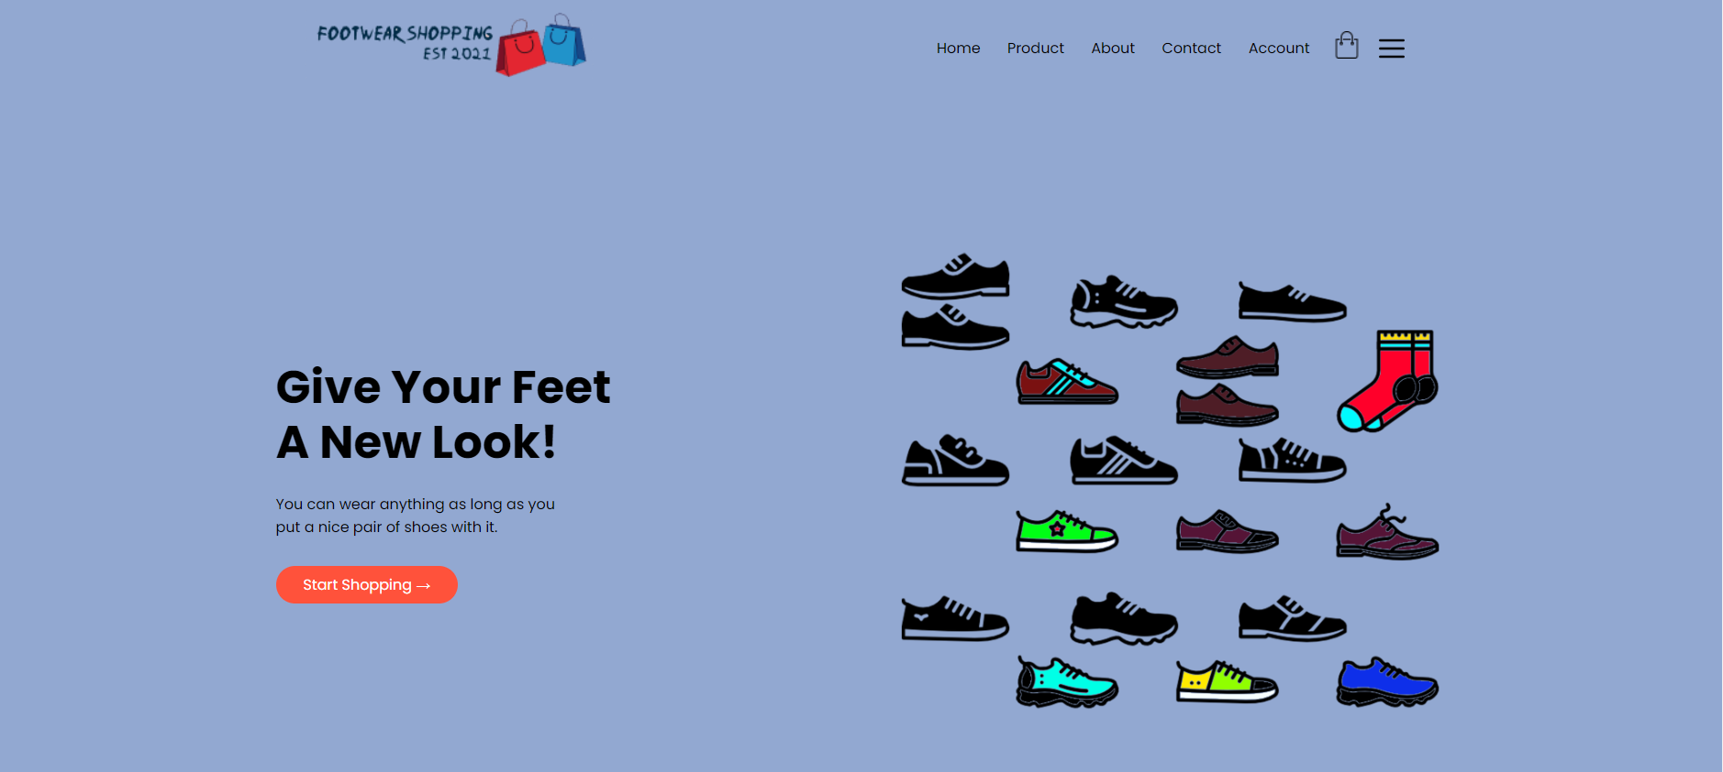
Home Page

Slide 8
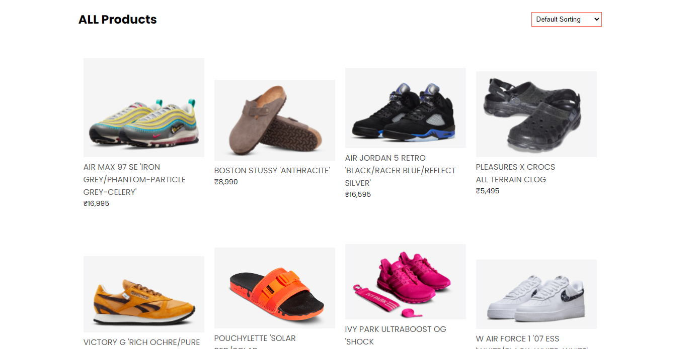
Product Page

Slide 9
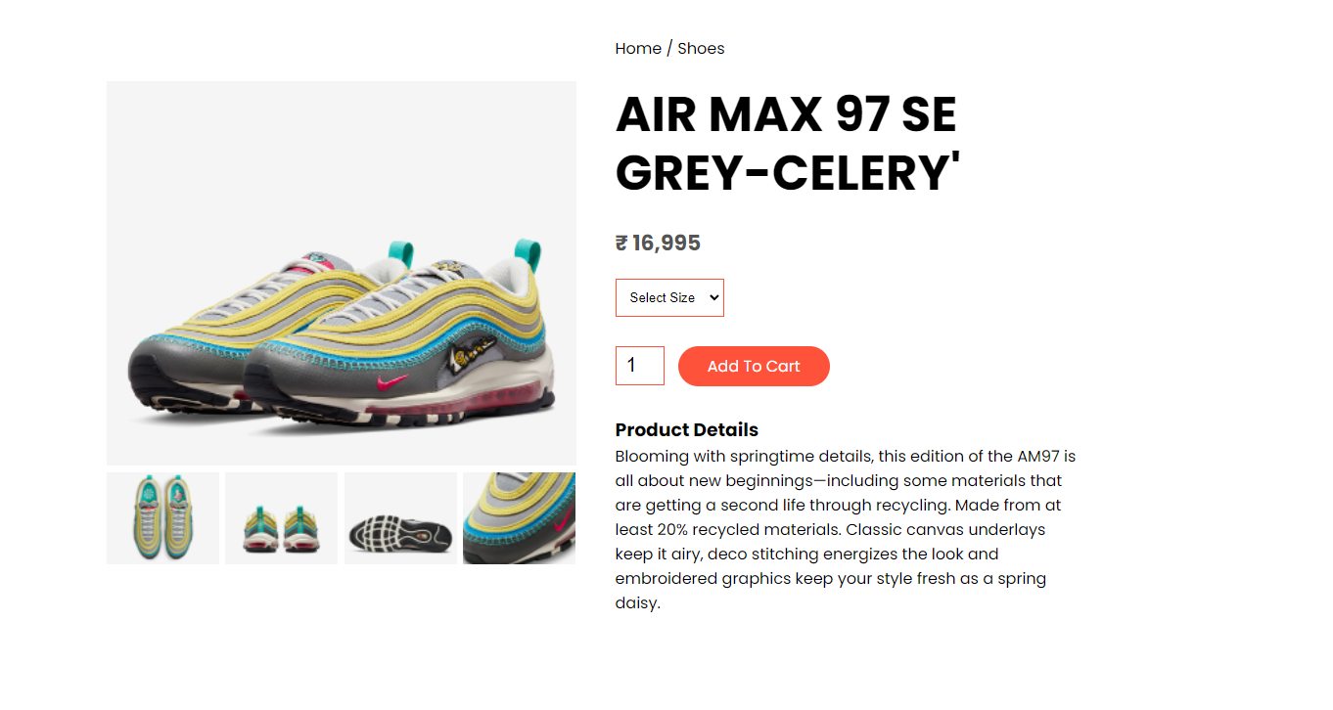
Product Details Page

Slide 10
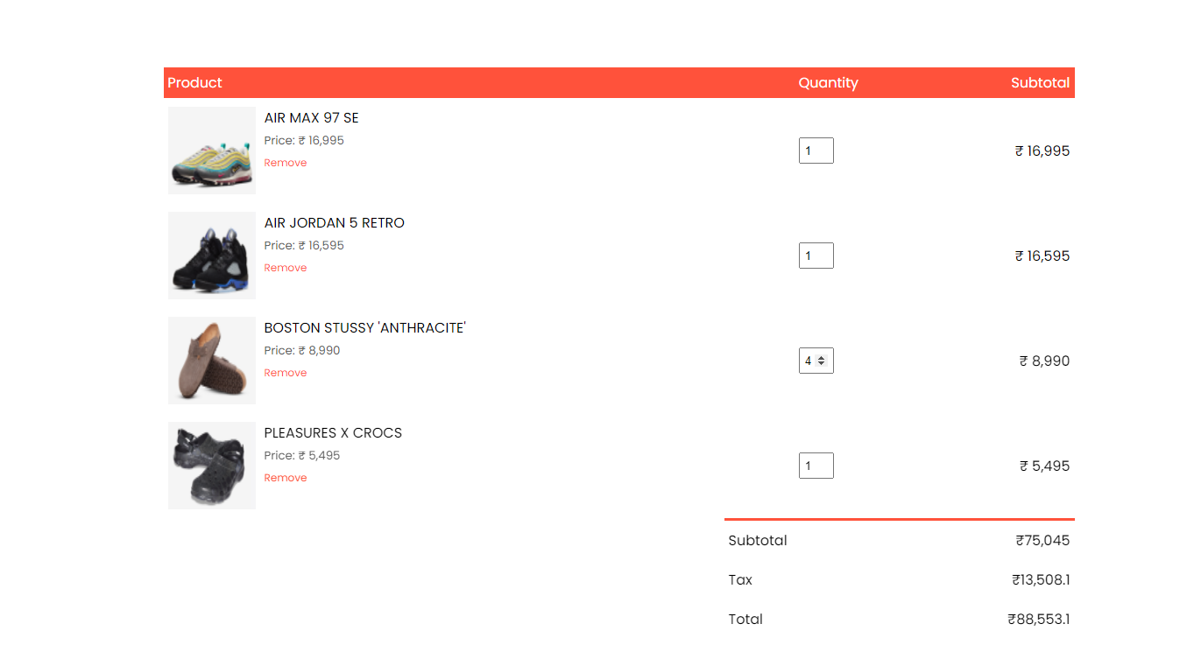
Cart Page

Slide 11
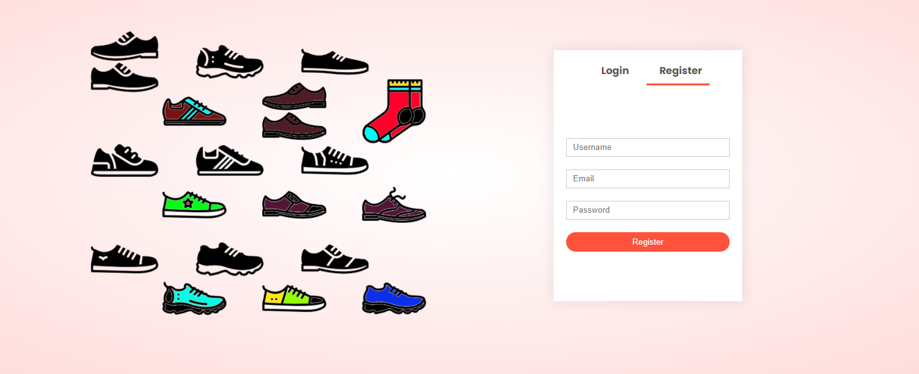
Accounts Page

Slide 12
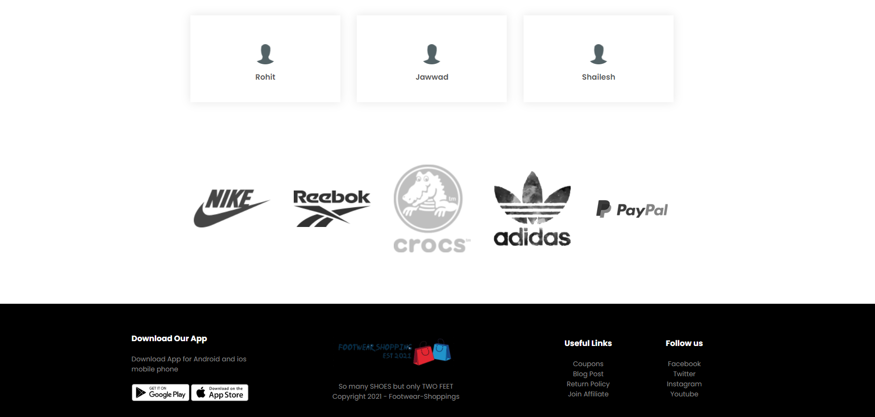
About and Contact Page

Slide 13
Conclusions
Fit and Comfort are the two most important factors for footwear evaluation. fit, comfort and style are closely related.
These three product cues are often used for footwear evaluation because ill fitting shoes may lead to physical pain and discomfort, and inappropriate style may lead to psychological discomfort.
Although visual cues such as style, color and fit play a more important role than many other product cues, many consumers are not able to decide on their purchases without touching and trying on the product.
Many consumers are not comfortable to purchase footwear online although a few that consumers are capable and knowledgeable to judge the clothing fit and quality based on its visual representation or physical appearance.
It could be quite different shopping for a pair of shoes than shopping for clothing. Clearly, consumers do not want to buy any shoes that may lead to physical pain and discomfort, regardless of the attractiveness of the shoes. The reasons why many shoppers have no confidence in judging the fit of shoes online include:
the visual representation and text descriptions do not provide enough information about the fit:
the sizing systems of footwear are varied across brand names:
some consumers’ feet sizes are beyond the norm (e.g., too small, too wide or too narrow). In order to enhance consumers’ online shopping confidence and experience, footwear retailers should address the aforementioned issues. In order to provide useful information to online shoppers, fashion retailers should focus on the following areas: understanding shoppers’ navigation styles and patterns, and displaying each visual product alongside reviewers’ comments as well as the availability of shoes sizes.

